Slide 1
PNEUMONIA DETECTION USING ENSEMBLE LEARNING
AKSHAYA K (211417104010)
ANUSHA R (211417104020)
HARRSHEETHA S(211417104082)
GUIDE- MRS.ANITHA MOSES (ASSOCIATE PROFESSOR)

Slide 2
INTRODUCTION
Pneumonia is an interstitial lung disease caused by bacteria, fungi or viruses. It accounted for approximately 16% of the 5.6 million under-five deaths, killing around 880,000 children in 2016 . Affected victims were mostly less than two years old
This paper presents convolutional neural network models to accurately detect pneumonic lungs from chest X-rays, which can be utilized in the real world by medical practitioners to treat pneumonia.
These models have been trained to classify chest X-ray images into normal and pneumonia in a few seconds, hence serving the purpose of early detection of pneumonia.
Although transfer learning models based on convolutional neural networks like ResNet50, VGG16 and VGG19 are some of the most successful ImageNet dataset models with pre-trained weights, they were not trained on this dataset as the size of dataset taken for our research is not as extensive compared to ones which generally employ transfer learning.
Accuracy of the model is directly correlated with the size of the dataset, that is, the use of large datasets helps improve the accuracy of the model, but there is no direct correlation between the number of convolutional layers and the accuracy of the model.
The objective of the paper is to develop CNN models from scratch which can classify and thus detect pneumonic patients from their chest X-rays with high validation accuracy, recall and F1 scores.

Slide 3
LITERATURE SURVEY
SNO | TITLE | PUBLICATION | YEAR | AUTHOR | INFERENCE
1 | Transfer Learning with Deep Convolutional Neural Network (CNN) for Pneumonia Detection Using Chest X-ray | MDPI APPLIED SCIENCE VOL 9 ISSUE 9 | May 2020 | Tawsifur R Muhammad E. H. Chowdhuryahman Amith Khandakar | Pneumonia is a life-threatening disease, which occurs in the lungs caused by either bacterial or viral infection. It can be life-endangering if not acted upon at the right time and thus the early diagnosis of pneumonia is vital. The paper aims to automatically detect bacterial and viral pneumonia using digital x-ray images. It provides a detailed report on advances in accurate detection of pneumonia and then presents the methodology adopted by the authors. Four dierent pre-trained deep Convolutional Neural Network (CNN): AlexNet, ResNet18, DenseNet201, and SqueezeNet were used for transfer learning.

Slide 4
SNO | TITLE | PUBLICATION | YEAR | AUTHOR | INFERENCE
2 | Mortality prediction in community-acquired pneumonia requiring mechanical ventilation; values of pneumonia and intensive care unit severity scores | NATIONAL LIBRARY OF MEDICINE VOL 8 ISSUE 3 | APRIL-2019 | Müge Aydoğdu Numan Ekim | Many different pneumonia scoring systems have been developed in order to assess the severity of pneumonia and to decide the ICU follow-up and treatment. The aim of this study is to evaluate the performances of pneumonia and ICU scores in predicting mortality in CAP patients requiring mechanical ventilation. A retrospective observational cohort study. Thirty eight female and 63 male, a total of 101 severe CAP patients, with the mean age of 68 +/- 16 years, were included in the study. ICU mortality rate was assessed as 55%. Ninety percent of all patients met the revised ATS criteria and 92% of them met the PSI scoring system for ICU admissions. Although the CURB-65, PSI, revised ATS criteria were not found valuable to predict mortality, the increased APACHE II score was found to be related with increased mortality rate (for APACHE II > 20 odds ratio: 3, 95% CI: 1.2-7, p= 0.024). These results suggest that instead of the pneumonia scoring systems the APACHE II score can best predict the ICU mortality. So, more attention should be paid for severe CAP patients with APACHE II score > 20.

Slide 5
SNO | TITLE | PUBLICATION | YEAR | AUTHOR | INFERENCE
3 | Identifying pneumonia in chest X-rays: A deep learning approach | SCIENCEDIRECT INTERNATIONAL JOURNAL- VOL 7 ISSUE 4 | October 2019 | Amit KumarJaiswal SachinKumar | The rich collection of annotated datasets piloted the robustness of deep learning techniques to effectuate the implementation of diverse medical imaging tasks. Over 15% of deaths include children under age five are caused by pneumonia globally. In this study, we describe our deep learning based approach for the identification and localization of pneumonia in Chest X-rays (CXRs) images. Researchers usually employ CXRs for the diagnostic imaging study. Several factors such as positioning of the patient and depth of inspiration can change the appearance of the chest X-ray, complicating interpretation further. Our identification model is based on Mask-RCNN, a deep neural network which incorporates global and local features for pixel-wise segmentation. Our approach achieves robustness through critical modifications of the training process and a novel post-processing step which merges bounding boxes from multiple models. The proposed identification model achieves better performances evaluated on chest radiograph dataset which depict potential pneumonia causes.

Slide 6
SNO | TITLE | PUBLICATION | YEAR | AUTHOR | INFERENCE
4 | A transfer learning method with deep residual network for pediatric pneumonia diagnosis | SCIENCEDIRECT INTERNATIONAL JOURNAL Computer Methods and Programs in Biomedicine VOL 9 ISSUE 8 | APRIL 2020 | Liang, G Zheng, L | Computer aided diagnosis systems based on deep learning and medical imaging is increasingly becoming research hotspots. At the moment, the classical convolutional neural network generates classification results by hierarchically abstracting the original image. These abstract features are less sensitive to the position and orientation of the object, and this lack of spatial information limits the further improvement of image classification accuracy. Therefore, how to develop a suitable neural network framework and training strategy in practical clinical applications to avoid this problem is a topic that researchers need to continue to explore.

Slide 7
SNO | TITLE | PUBLICATION | YEAR | AUTHOR | INFERENCE
5 | An automatic method for lung segmentation and reconstruction in chest X-ray using deep neural networks | SCIENCEDIRECT INTERNATIONAL JOURNAL- VOL4 ISSUE 6 | August 2019, | Souza, J.C Diniz, J.O.B Ferreira, J.L | Chest X-ray (CXR) is one of the most used imaging techniques for detection and diagnosis of pulmonary diseases. A critical component in any computer-aided system, for either detection or diagnosis in digital CXR, is the automatic segmentation of the lung field. One of the main challenges inherent to this task is to include in the segmentation the lung regions overlapped by dense abnormalities, also known as opacities, which can be caused by diseases such as tuberculosis and pneumonia. This specific task is difficult because opacities frequently reach high intensity values which can be incorrectly interpreted by an automatic method as the lung boundary, and as a consequence, this creates a challenge in the segmentation process, because the chances of incomplete segmentations are increased considerably. The purpose of this work is to propose a method for automatic segmentation of lungs in CXR that addresses this problem by reconstructing the lung regions “lost” due to pulmonary abnormalities.

Slide 8
SNO | TITLE | PUBLICATION | YEAR | AUTHOR | INFERENCE
6 | Effective feature learning and fusion of multimodality data using stage-wise deep neural network for dementia diagnosis | Hum. Brain Mapp. 2018, 40, 1001–1016. | MAY 2018 | Zhou, T.; Thung, K.; Zhu, X.; Shen, D. | In this article, the authors aim to maximally utilize multimodality neuroimaging and genetic data for identifying Alzheimer's disease (AD) and its prodromal status, Mild Cognitive Impairment (MCI), from normal aging subjects. Multimodality neuroimaging data such as MRI and PET provide valuable insights into brain abnormalities, while genetic data such as single nucleotide polymorphism (SNP) provide information about a patient's AD risk factors. When these data are used together, the accuracy of AD diagnosis may be improved. However, these data are heterogeneous (e.g., with different data distributions), and have different number of samples (e.g., with far less number of PET samples than the number of MRI or SNPs). Thus, learning an effective model using these data is challenging. To this end, we present a novel three-stage deep feature learning and fusion framework, where deep neural network is trained stage-wise. Each stage of the network learns feature representations for different combinations of modalities, via effective training using the maximum number of available samples.

Slide 9
SNO | TITLE | PUBLICATION | YEAR | AUTHOR | INFERENCE
7 | A survey of recent advances in deep learning techniques for electronic health record (EHR) analysis | Biomed. Health Inform. 2018, VOL 22, 1589–1604 ISSUE 9 | MAY 2018 | Shickel, B.; Tighe, P.J.; Bihorac, A.; Rashidi, P. Deep EHR | The past decade has seen an explosion in the amount of digital information stored in electronic health records (EHRs). While primarily designed for archiving patient information and performing administrative healthcare tasks like billing, many researchers have found secondary use of these records for various clinical informatics applications. Over the same period, the machine learning community has seen widespread advances in the field of deep learning. In this review, we survey the current research on applying deep learning to clinical tasks based on EHR data, where we find a variety of deep learning techniques and frameworks being applied to several types of clinical applications including information extraction, representation learning, outcome prediction, phenotyping, and deidentification. We identify several limitations of current research involving topics such as model interpretability, data heterogeneity, and lack of universal benchmarks. We conclude by summarizing the state of the field and identifying avenues of future deep EHR research.

Slide 10
SNO | TITLE | PUBLICATION | YEAR | AUTHOR | INFERENCE
8 | Survey on deep learning for radiotherapy | Comput. Biol. Med. 2018, 98, 126–146. Appl. Sci. 2020, 10, 559 15 of 17 | JUNE 2020 | Meyer, P.; Noblet, V.; Mazzara, C.; Lallement | More than 50% of cancer patients are treated with radiotherapy, either exclusively or in combination with other methods. The planning and delivery of radiotherapy treatment is a complex process, but can now be greatly facilitated by artificial intelligence technology. Deep learning is the fastest-growing field in artificial intelligence and has been successfully used in recent years in many domains, including medicine. In this article, we first explain the concept of deep learning, addressing it in the broader context of machine learning. The most common network architectures are presented, with a more specific focus on convolutional neural networks. We then present a review of the published works on deep learning methods that can be applied to radiotherapy, which are classified into seven categories related to the patient workflow, and can provide some insights of potential future applications. We have attempted to make this paper accessible to both radiotherapy and deep learning communities, and hope that it will inspire new collaborations between these two communities to develop dedicated radiotherapy applications.

Slide 11
SNO | TITLE | PUBLICATION | YEAR | AUTHOR | INFERENCE
9 | How far have we come? Artificial intelligence for chest radiograph interpretation | PubMed.gov NATIONAL LIBRARY OF MEDICINE VOL 3 ISSUE 6 | 2019 | Kallianos, K.; Mongan, J.; Antani, S.; Henry, T.; Taylor, A.; Abuya, J.; Kohli, M | Due to recent advances in artificial intelligence, there is renewed interest in automating interpretation of imaging tests. Chest radiographs are particularly interesting due to many factors: relatively inexpensive equipment, importance to public health, commonly performed throughout the world, and deceptively complex taking years to master. This article presents a brief introduction to artificial intelligence, reviews the progress to date in chest radiograph interpretation, and provides a snapshot of the available datasets and algorithms available to chest radiograph researchers. Finally, the limitations of artificial intelligence with respect to interpretation of imaging studies are discussed.

Slide 12
SNO | TITLE | PUBLICATION | YEAR | AUTHOR | INFERENCE
10 | Efficient deep network architectures for fast chest X-ray tuberculosis screening and visualization | SCIENTIFIC REPORT VOL 10 ISSUE 2 | 18 April 2019 | Pasa, F.; Golkov, V.; Pfeiffer, F.; Cremers, D.; Pfeiffer, D | Automated diagnosis of tuberculosis (TB) from chest X-Rays (CXR) has been tackled with either hand-crafted algorithms or machine learning approaches such as support vector machines (SVMs) and convolutional neural networks (CNNs). Most deep neural network applied to the task of tuberculosis diagnosis have been adapted from natural image classification. These models have a large number of parameters as well as high hardware requirements, which makes them prone to overfitting and harder to deploy in mobile settings. We propose a simple convolutional neural network optimized for the problem which is faster and more efficient than previous models but preserves their accuracy. Moreover, the visualization capabilities of CNNs have not been fully investigated. We test saliency maps and grad-CAMs as tuberculosis visualization methods, and discuss them from a radiological perspective

Slide 13
PROBLEM STATEMENT
In present day, one in three deaths in India is caused due to pneumonia as reported by World Health Organization (WHO).Thus, developing an automatic system for detecting pneumonia would be beneficial for treating the disease without any delay particularly in remote areas. Due to the success of deep learning algorithms in analyzing medical images, Convolutional Neural Networks (CNNs) have gained much attention for disease classification. In this work, we appraise the functionality of pre-trained CNN models utilized as feature-extractors followed by different classifiers for the classification of abnormal and normal chest X-Rays. We analytically determine the optimal CNN model for the purpose.

Slide 14
TECHNOLOGY STACK
SYSTEM REQUIREMENTS:
HARDWARE REQUIREMENTS:
System : Intel Core 2 Duo.
Hard Disk : 40 GB.
Monitor : 15 VGA Color.
Mouse : Logitech.
Ram : 2GB.
SOFTWARE CONFIGURATION:-
Operating System : Windows 8/Windows 10
Programming Language : Python
Front End : Jupyter Notebook.

Slide 15
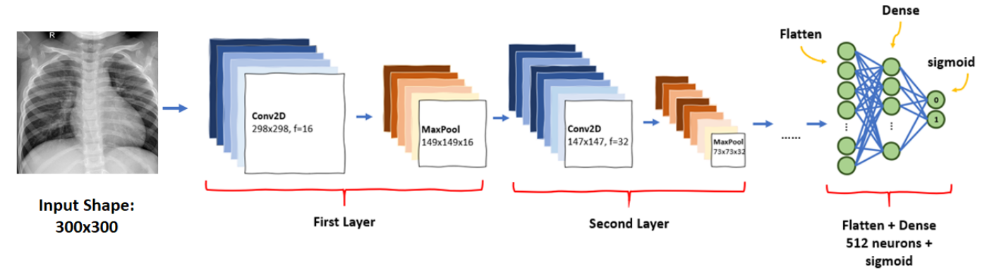
SYSTEM ARCHITECTURE

Slide 16

Convolutional Neural Network (ConvNet/CNN)
A Convolutional Neural Network (ConvNet/CNN) is a Deep Learning algorithm which can take in an input image, assign importance (learnable weights and biases) to various aspects/objects in the image and be able to differentiate one from the other

Slide 17
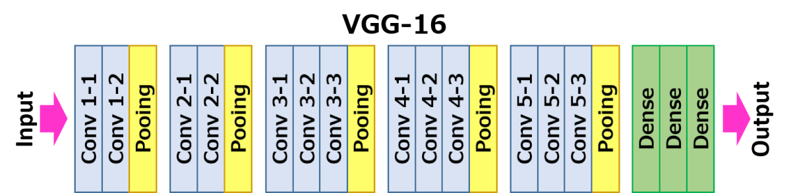
VGG16(Visual Geometry Group)
VGG16 is a convolutional neural network model
The model achieves 92.7% top-5 test accuracy in ImageNet, which is a dataset of over 14 million images belonging to 1000 classes. It was one of the famous model submitted

Slide 18
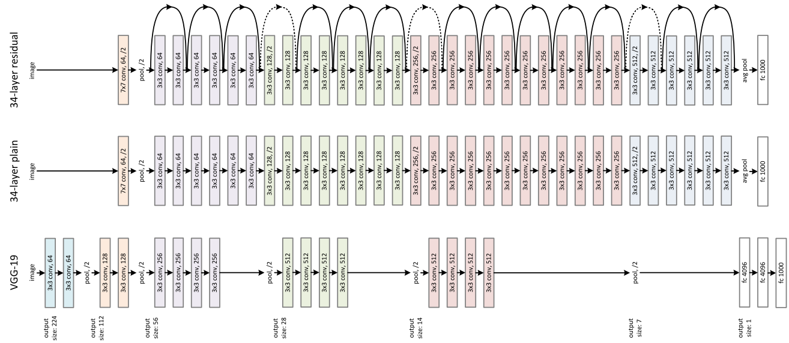
ResNet50
ResNet, short for Residual Networks is a classic neural network used as a backbone for many computer vision tasks.
The fundamental breakthrough with ResNet was it allowed us to train extremely deep neural networks with 150+layers successfully. Prior to ResNet training very deep neural networks was difficult due to the problem of vanishing gradients.

Slide 19
MODULES
PROPOSED MODEL
Modules
Dataset Collection
Data Preprocessing
Splitting training and testing data
Build CNN VGG16 AND RESNET50 model
Testing and evaluate the model

Slide 20
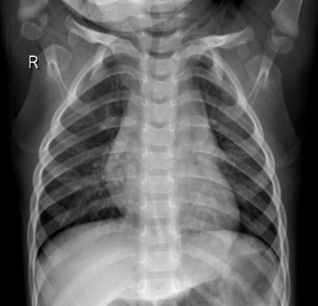
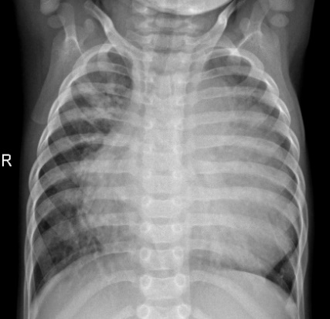
DATASET
The chest x-ray image dataset for pneumonia detection consists of two categories of images – Pneumonia and normal. A total of 5,216 images are assigned to the training set and 624 images are assigned to the test set.
Normal patient
Pneumonia affected patient

Slide 21
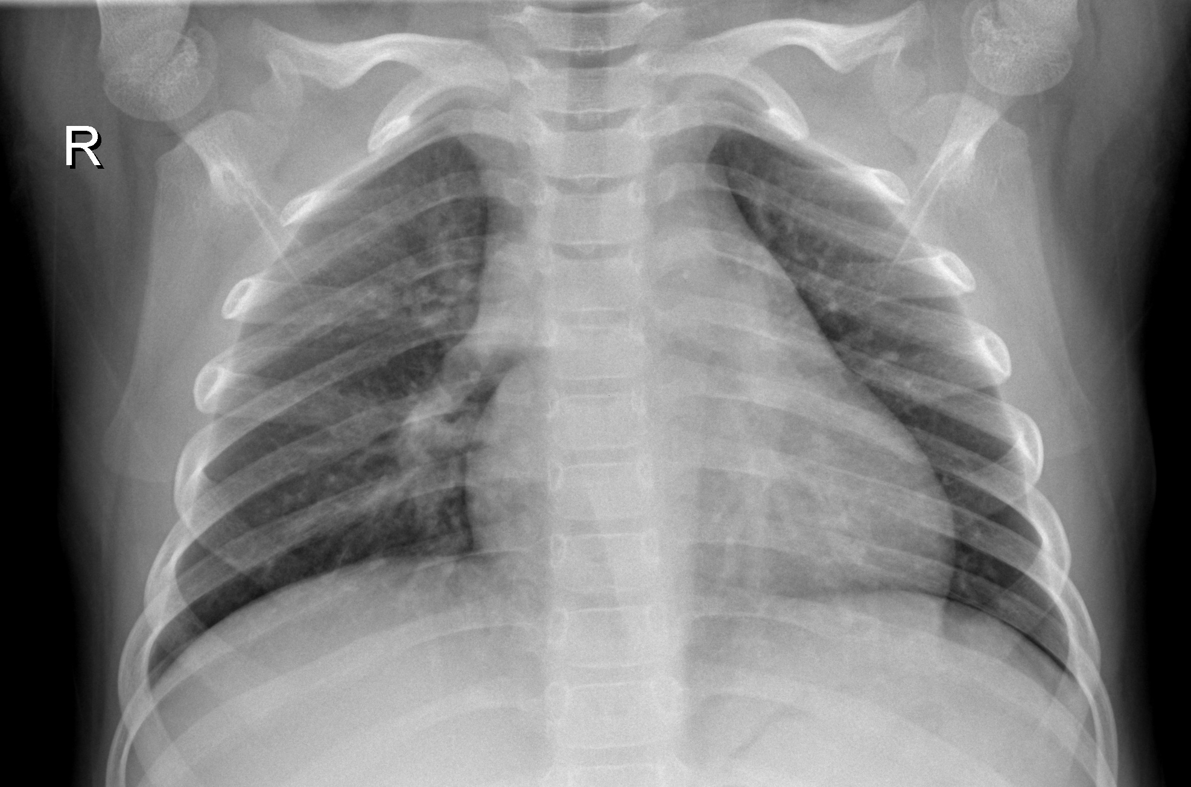
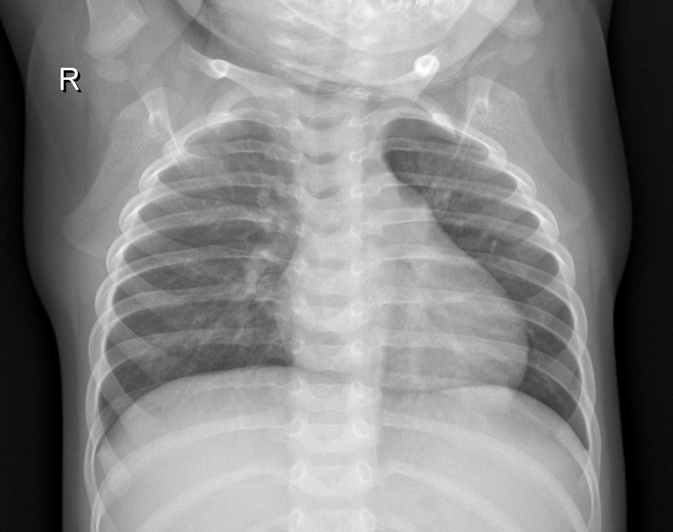
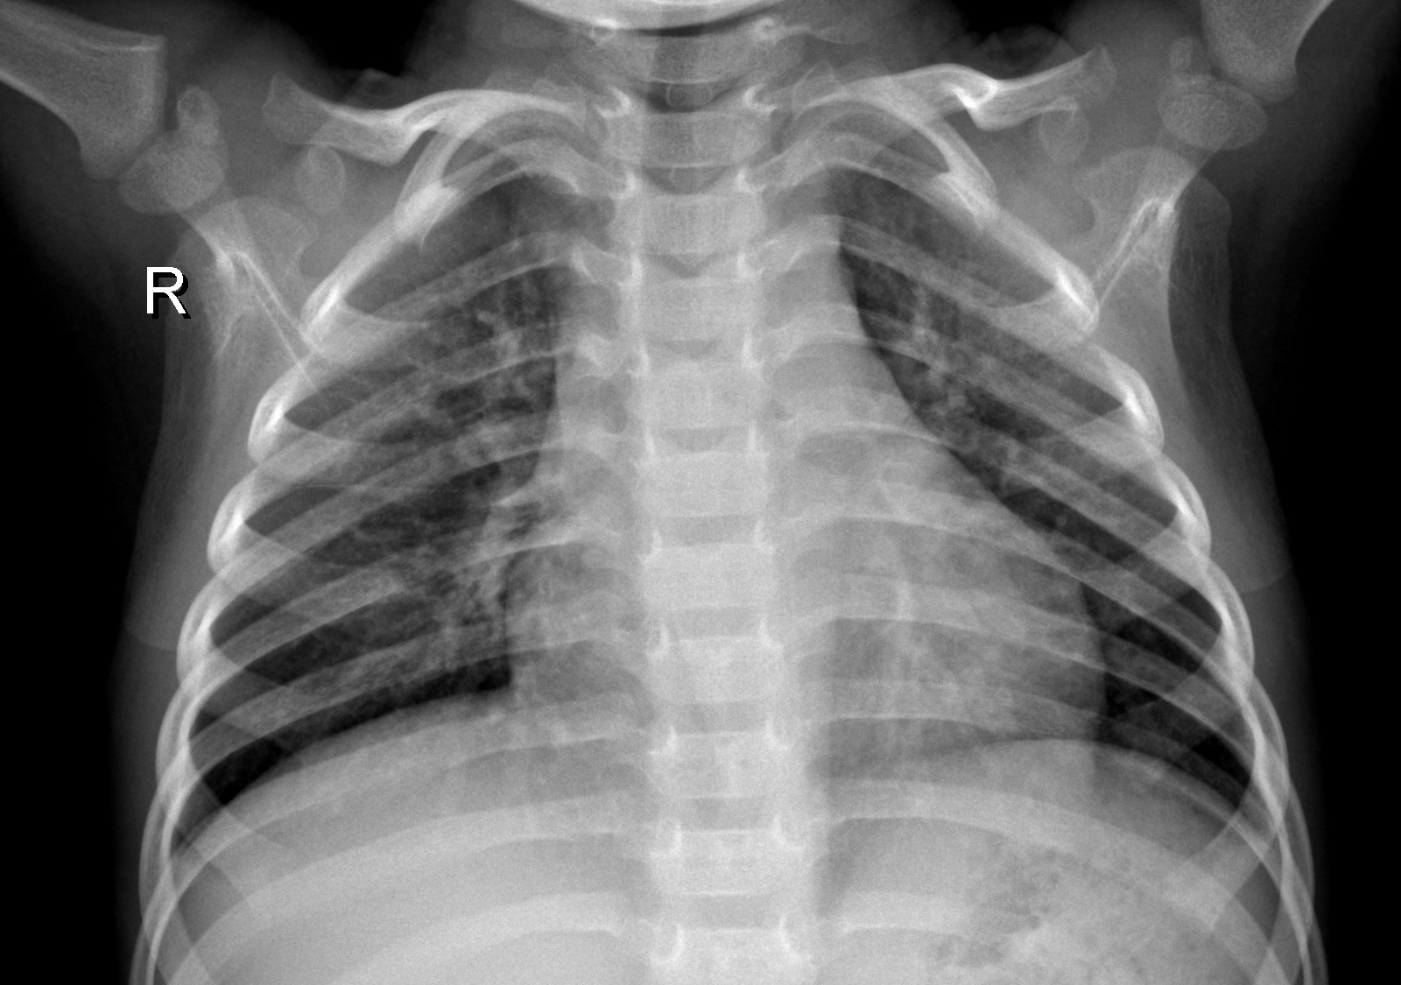
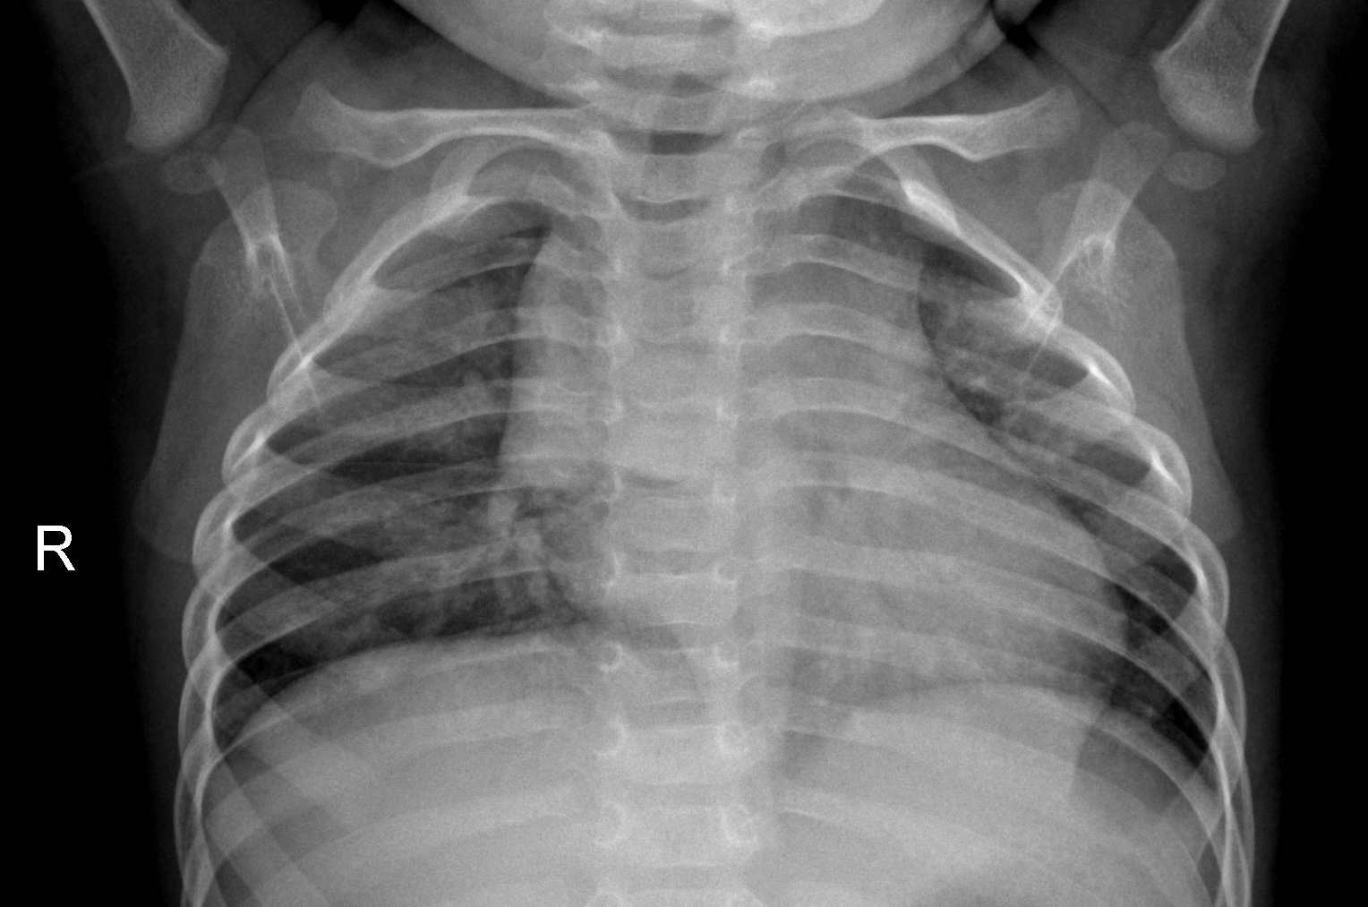
NORMAL LUNGS ( IMAGES FROM KAGGLE SITE )

Slide 22
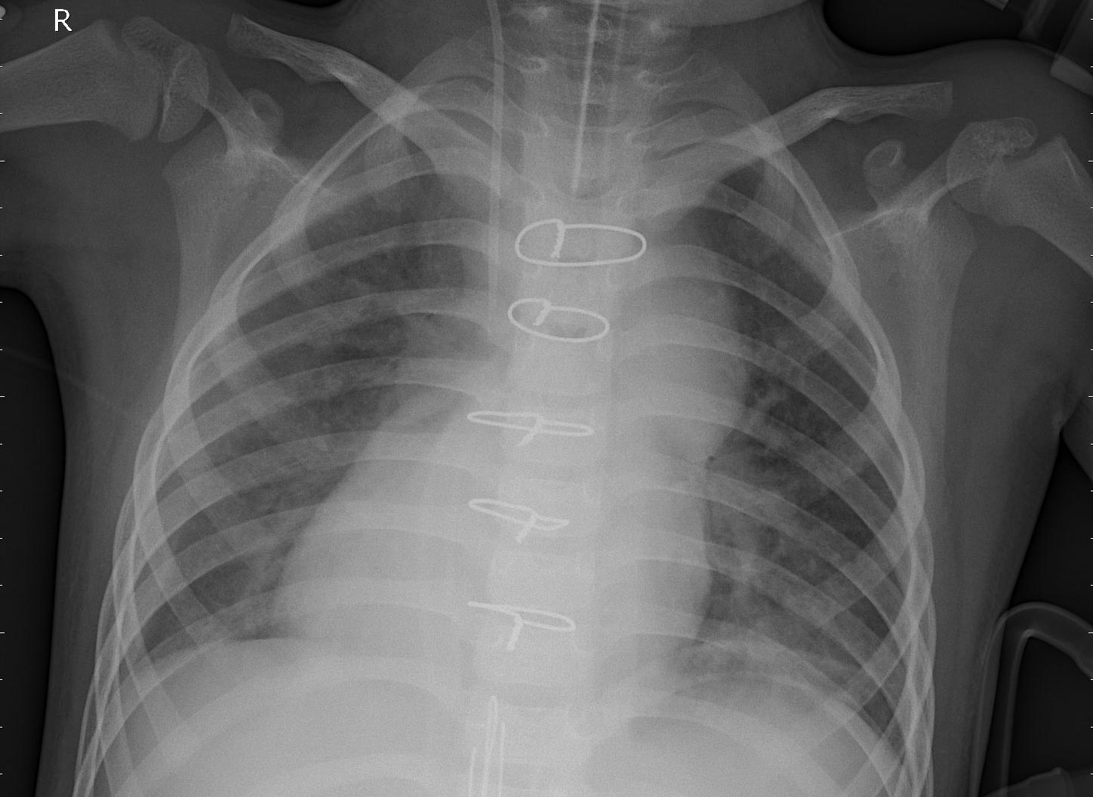
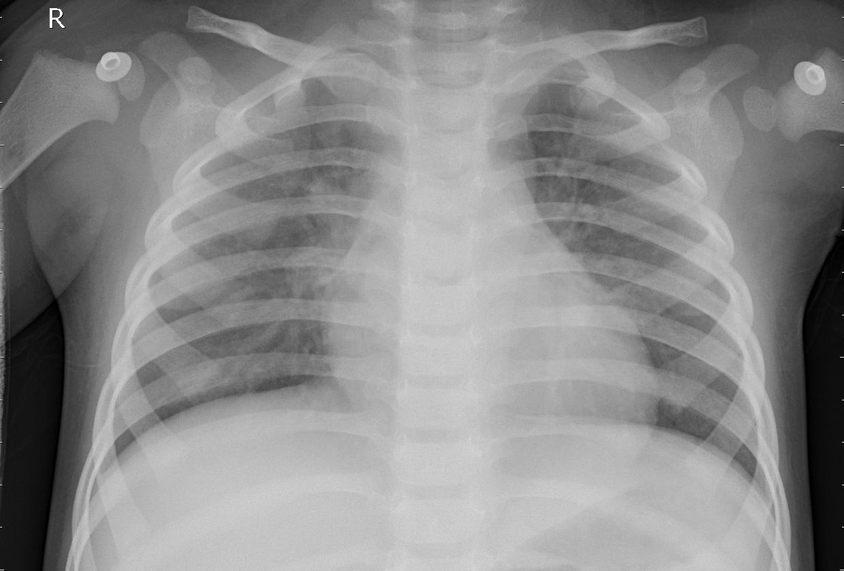
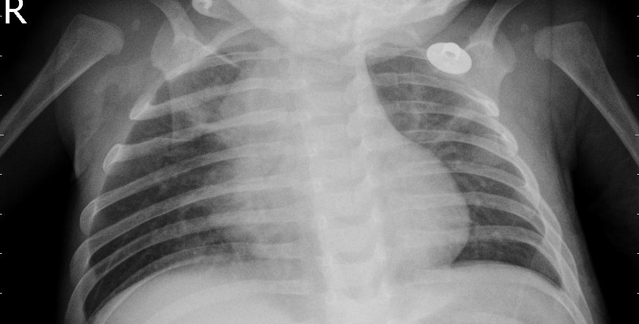
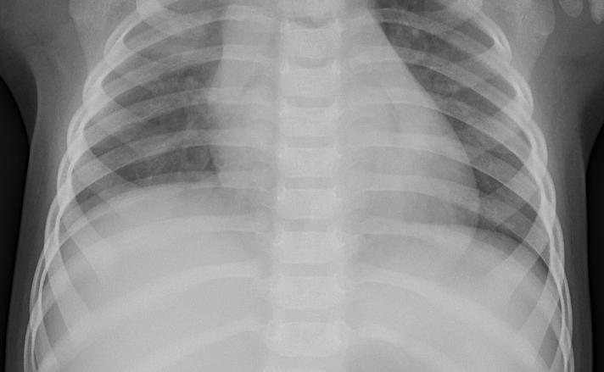
Pneumonia affected patient (IMAGES FROM KAGGLE)

Slide 23
DATA PREPROCESSING
In this work, several preprocessing methods were employed to increase the quality of the image data. The rescale operation was used for image size reduction, since the images were of various dimensions. The input images are generated using ImageDataGenerator class and augmentation techniques are used to rotate, shift and zoom the images. The rotation range of 10 denotes the range in which the images were randomly rotated during training. Width shift is the horizontal translation of the images by 0.1 percent and height shift is the vertical translation of the images by 0.1 percent. The zoom range randomly zooms the images to the ratio of 0.2 percent

Slide 24
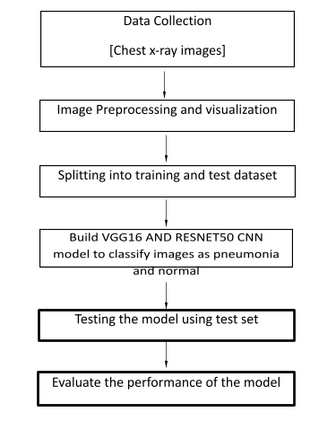
Workflow for development of the model:

Slide 25
As illustrated above, the first step is data collection. It is followed by data preprocessing to prepare the data for application of algorithm. Then, VGG16 AND RESNET50 CNN architecture is built to classify images as pneumonia and normal. The testing phase involves predicting the presence of pneumonia in X-ray image using the trained model. Finally, the performance of the model is evaluated using various metrics.

Slide 26
ALGORITHM
Convolutional Neural Network (CNN) is a deep learning algorithm that can recognize and classify features in images for computer vision. It is a multi-layer neural network designed to analyze visual inputs and perform image classification. It assigns importance to various aspects in the image and differentiate one from the other. This work implemented the VGG16 AND RESNET50 (Visual Geometry Group) model, which is a CNN transfer learning model.
The architecture consists of 16 layers. There are 2 contiguous blocks of 2 convolution layers, each block followed by max-pooling. Then, there are 3 contiguous blocks of 3 convolution layers, each block followed by max-pooling. At last, there are 3 dense layers. After developing the model, it is trained in batches of 32 images. The evaluation metric used for model is accuracy. The loss function used is sparse categorical crossentropy because the classes are mutually exclusive (i.e) each image belongs exactly to one class. The optimizer function used in the model is Adam optimizer.

Slide 27
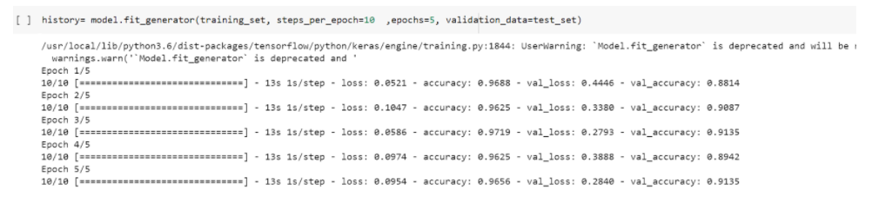
TESTING/ PERFORMANCE EVALUATION/ RESULTS
UNIT TESTING
Test strategy and approach
Field testing will be performed manually and functional tests will be written in detail.
Test objectives
All field entries must work properly.
Pages must be activated from the identified link.
The entry screen, messages and responses must not be delayed.
Features to be tested
Verify that the entries are of the correct format
No duplicate entries should be allowed
All links should take the user to the correct page

Slide 28
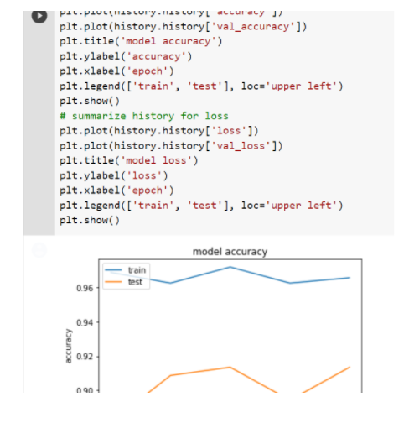
INTEGRATION TESTING
Integration tests are designed to test integrated software components to determine if they actually run as one program. Testing I
is event driven and is more concerned with the basic outcome of screens or fields. Integration tests demonstrate that although the components were individually satisfied, as shown by successfully unit testing, the combination of components is correct and consistent. Integration testing is specifically aimed at exposing the problems that arise from the combination of components

Slide 29
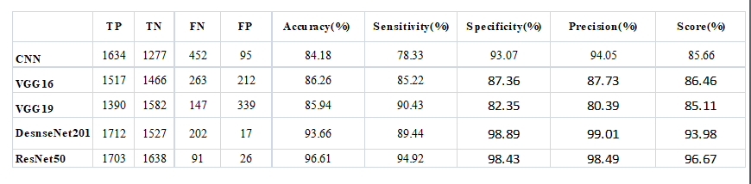
PERFORMANCE REPORT

Slide 30
CONCLUSION
Our goal is to propose a deep learning-based approach to classify pneumonia from chest X-ray images using transfer learning. In this framework, we adopted the transfer learning approach and used the pretrained architectures, VGG16 and ResNet trained on the ImageNet dataset, to extract features. These features were passed to the classifiers of respective models, and the output was collected from individual architectures. Finally, we employed an ensemble model that used pretrained models and outperformed all other models.
Our results suggest that deep learning methods can be used to improve diagnosis relative to traditional methods, which may improve the quality of treatment. When compared with the previous state-of-the-art methods, our approach can effectively detect the inflammatory region in chest X-ray images. Furthermore, the obtained results show that the Resnet50, gave highly performance (accuracy is more than 96%) against other architectures cited in this work (accuracy is around 85%).
These convolutional neural networks’ models were successfully achieved by employing various methods of parameter tuning like adding dropout, changing learning rates, changing the batch size, number of epochs, adding more complex fully connected layers and changing various stochastic gradient optimizers

Slide 31
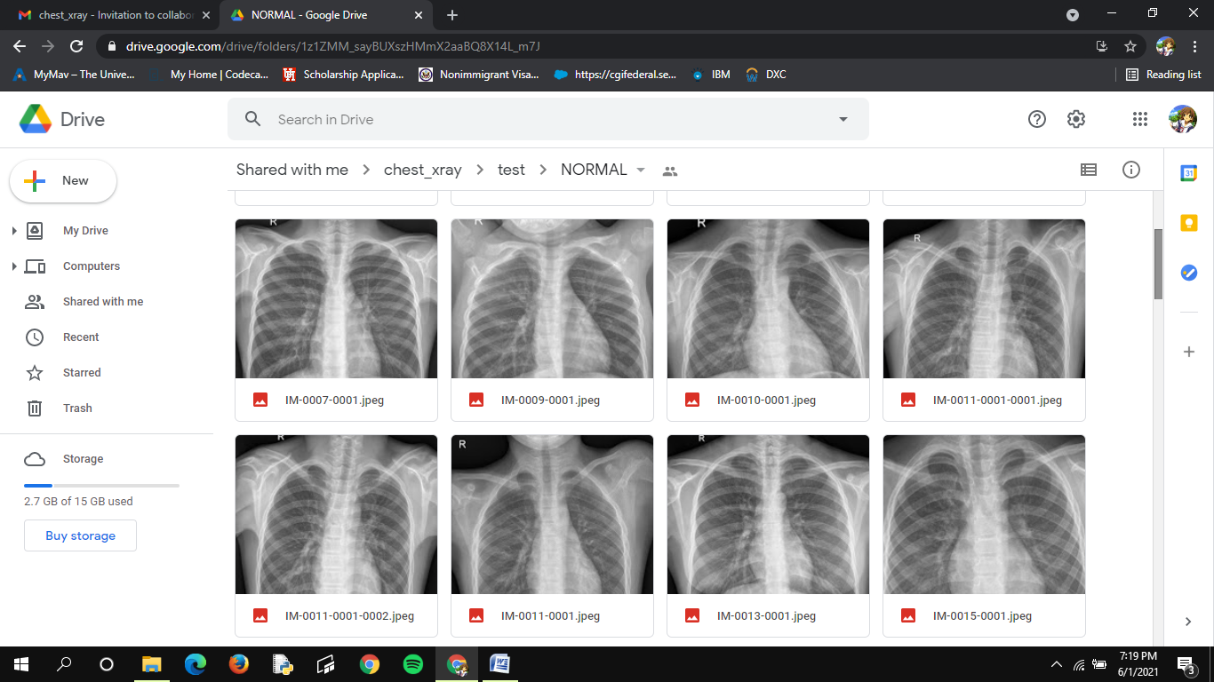
PICTURE OF NORMAL LUNGS

Slide 32
PICTURE OF PNEUMONIA AFFECTED LUNGS

Slide 33
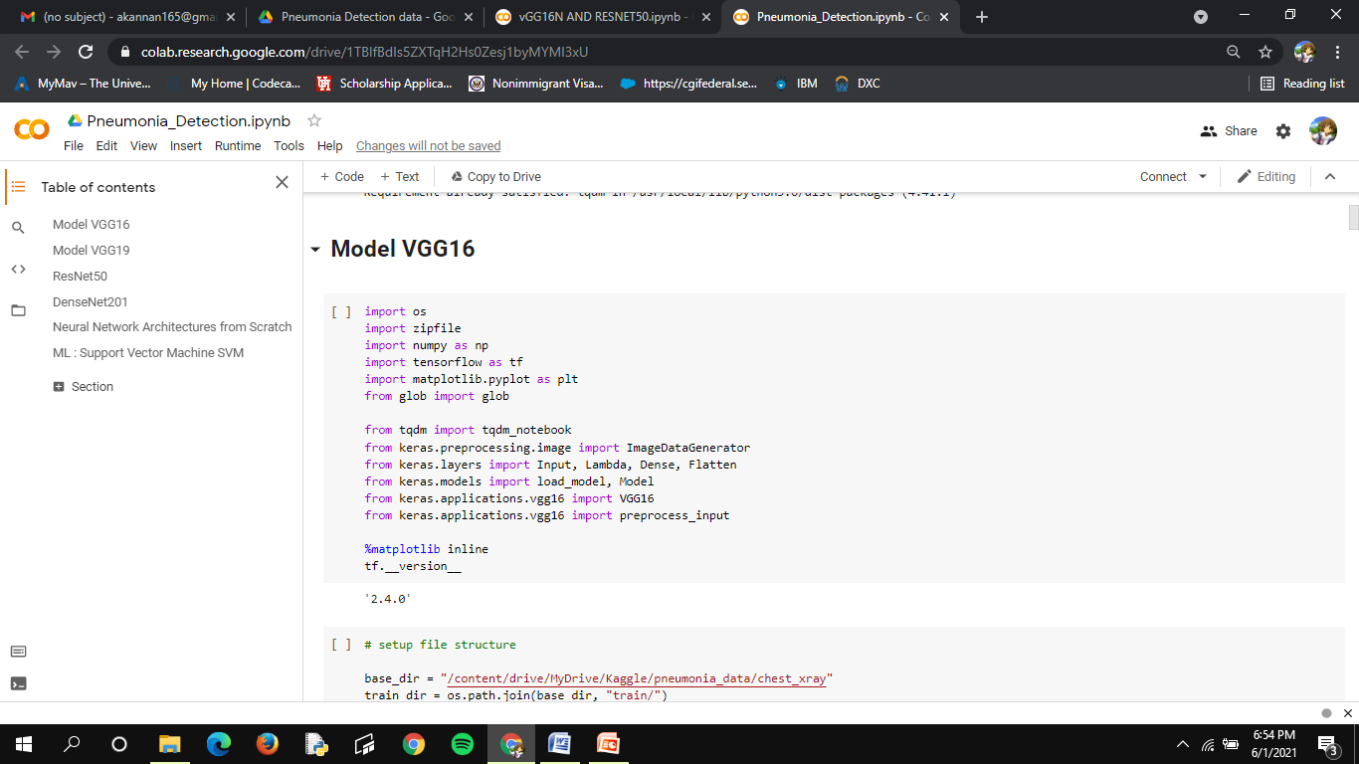
MODEL VGG16

Slide 34
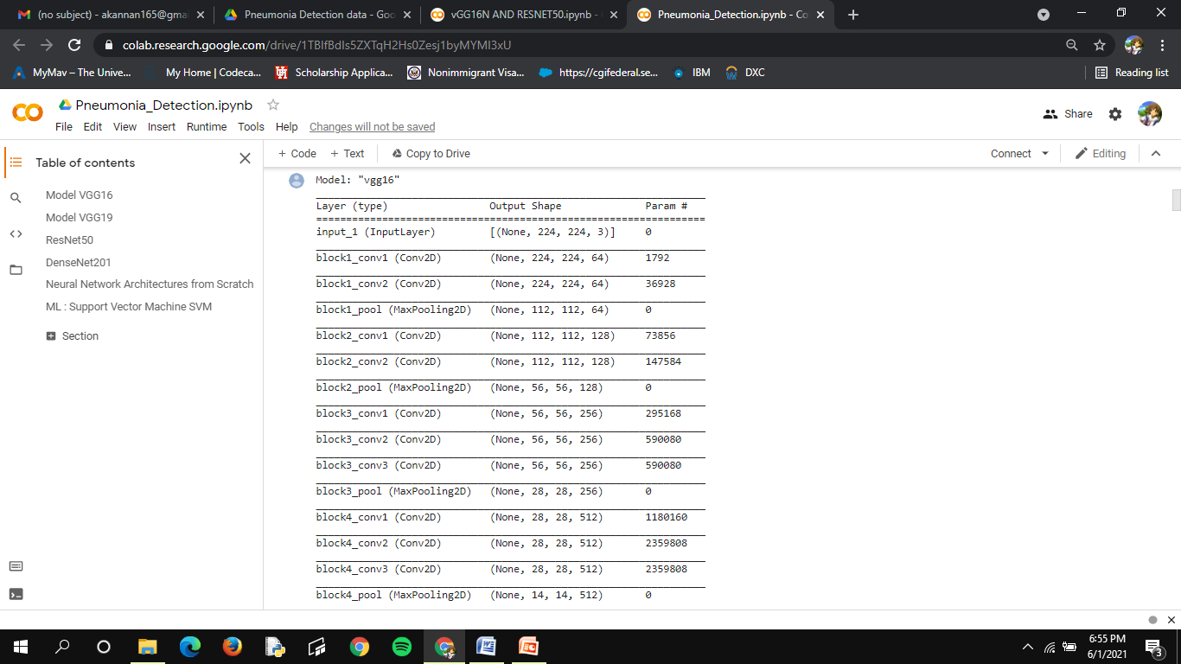
VGG16 SUMMARY

Slide 35
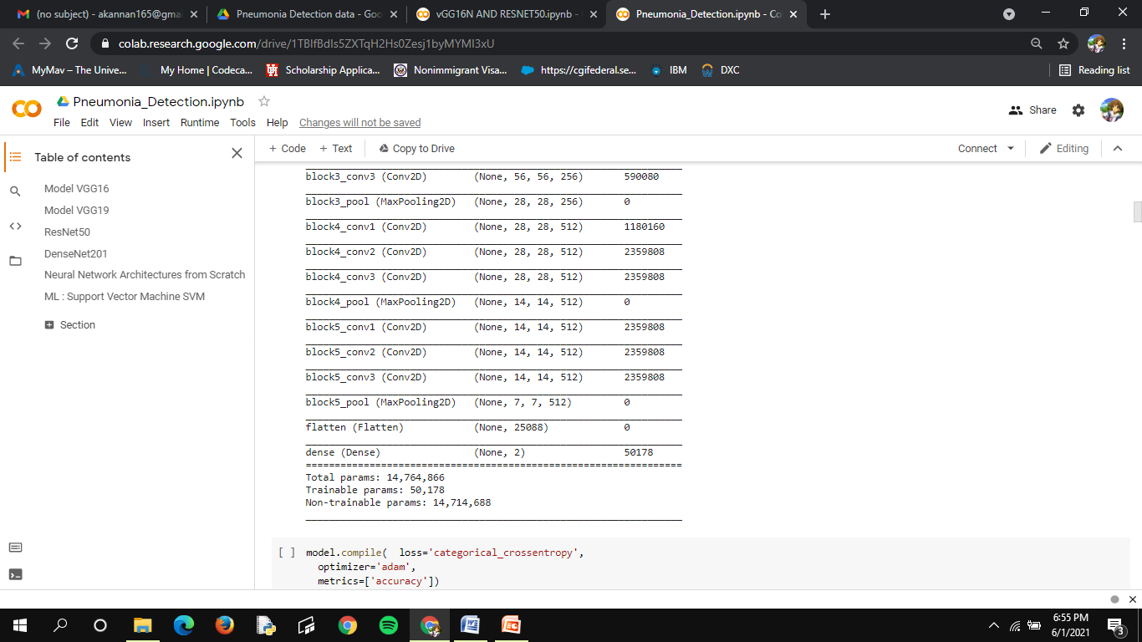

Slide 36
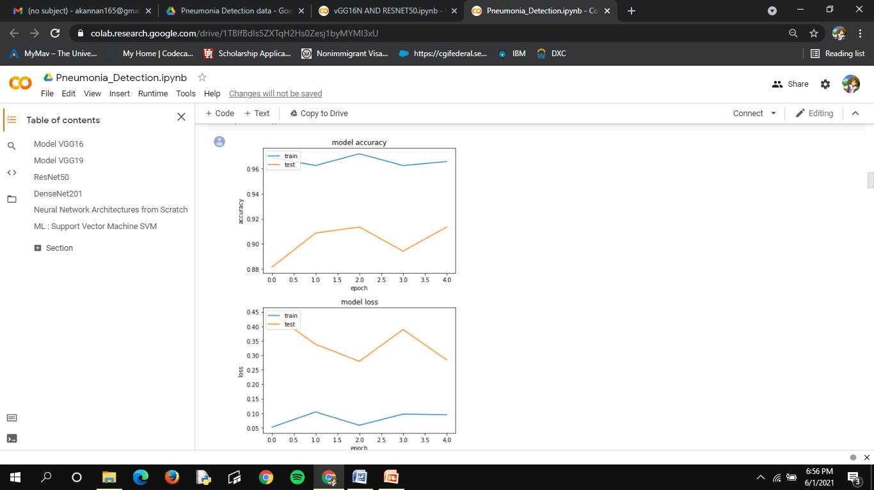
Model VGG16 Model accuracy and loss

Slide 37
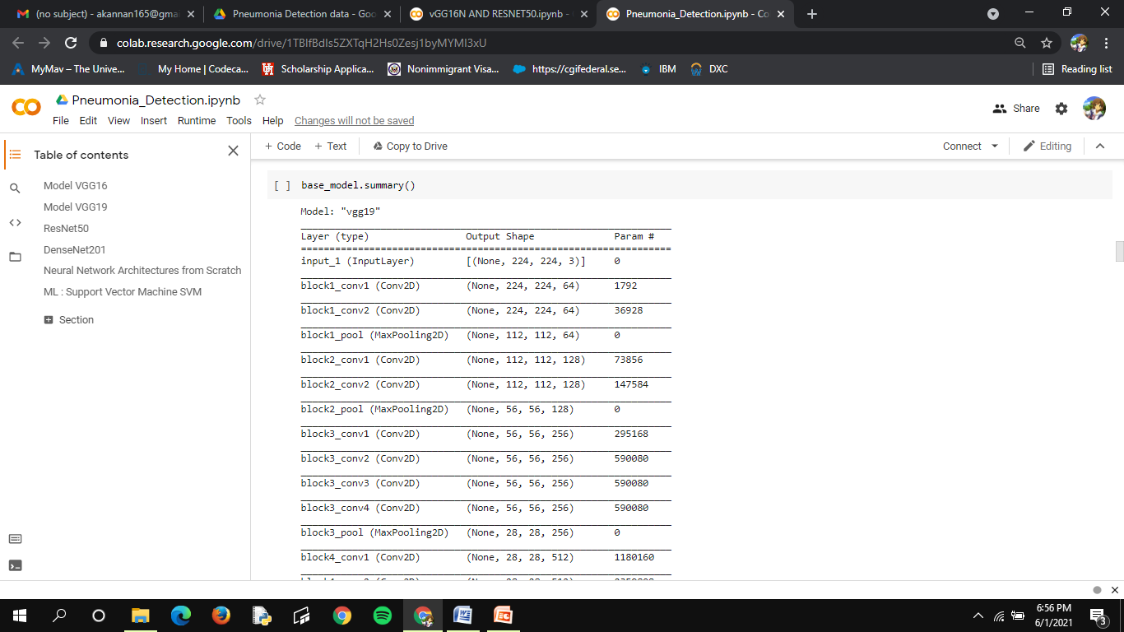
Model VGG16 Summary

Slide 38
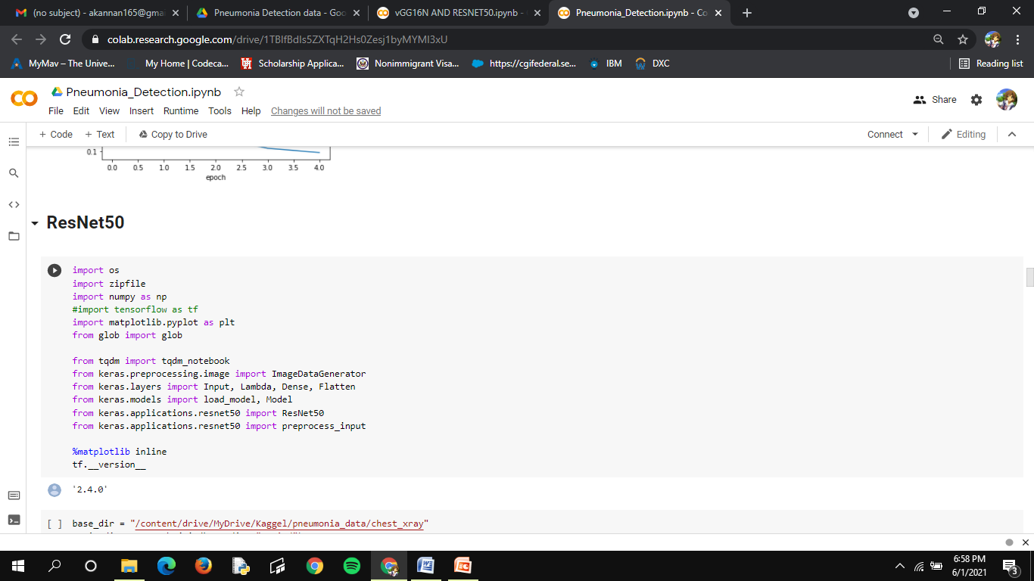
Resnet50

Slide 39
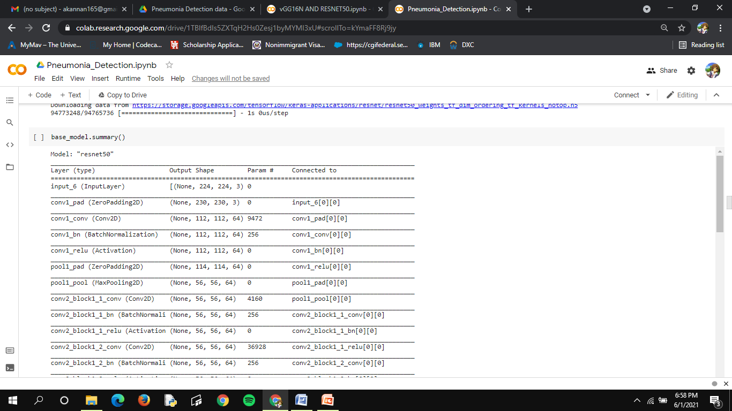
Resnest50 model summary

Slide 40
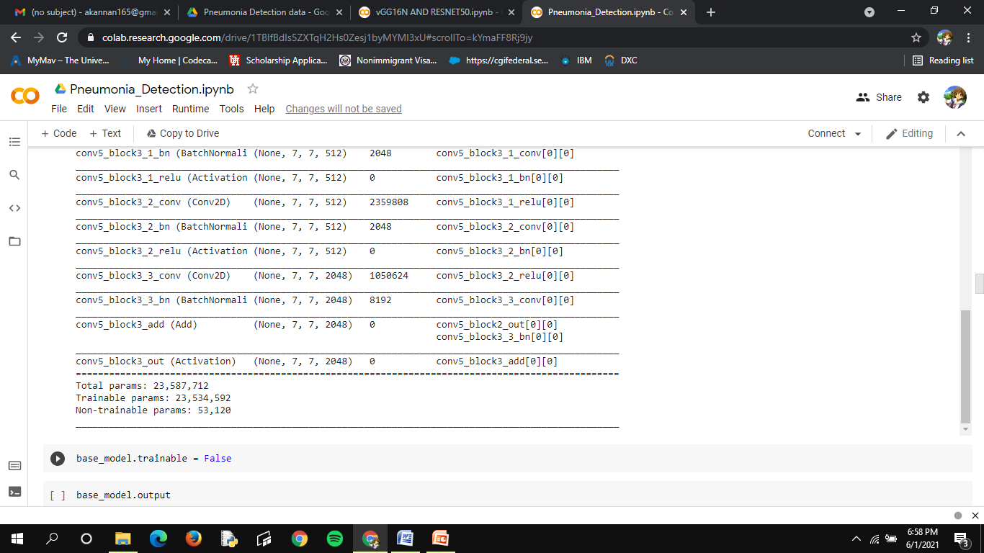

Slide 41
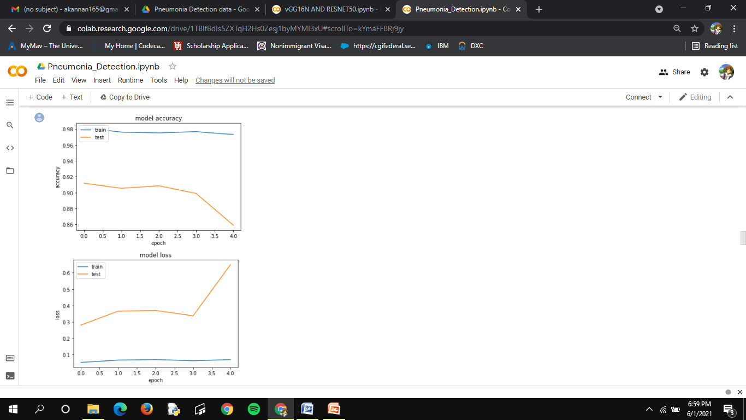
Resnest50 model accuracy and loss

Slide 42
REFERENCES
Albawi, S.; Mohammed, T.A.; Al-Zawi, S. Understanding of a convolutional neural network. In Proceedings of the 2017 International Conference on Engineering and Technology (ICET), Antalya, Turkey, 21–23 Augus 2017; pp. 1–6.
Asiri, N.; Hussain, M.; Al Adel, F.; Alzaidi, N. Deep learning based computer-aided diagnosis systems fordiabetic retinopathy: A survey. Artif. Intell. Med. 2019, 99.
Bailer, C.; Habtegebrial, T.; Varanasi, K.; Stricker, D. Fast Feature Extraction with CNNs with Pooling Layers. arXiv 2018, arXiv:1805.03096.
Bakator, M.; Radosav, D. Deep Learning and Medical Diagnosis: A Review of Literature. Multimodal Technol. Interact. 2018, 2, 47.
Behzadi-khormouji, H.; Rostami, H.; Salehi, S.; Derakhshande-Rishehri, T.; Masoumi, M.; Salemi, S.; Keshavarz, A.; Gholamrezanezhad, A.; Assadi, M.; Batouli, A. Deep learning, reusable and problem-based architectures for detection of consolidation on chest X-ray images. Comput. Methods Programs Biomed. 2020, 185, 105162. [PubMed]
Bouch, C.; Williams, G. Recently published papers: Pneumonia, hypothermia and the elderly. Crit. Care 2006, 10, 167. [PubMed]
Brunetti, A.; Carnimeo, L.; Trotta, G.F.; Bevilacqua, V. Computer-assisted frameworks for classification of liver, breast and blood neoplasias via neural networks: A survey based on medical images. Neurocomputing 2019, 335, 274–298.
Cohen, J.P.; Bertin, P.; Frappier, V. Chester: A Web Delivered Locally Computed Chest X-Ray Disease Prediction System. arXiv 2019, arXiv:1901.11210.
Da Nóbrega, R.V.M.; Rebouças Filho, P.P.; Rodrigues, M.B.; da Silva, S.P.P.; Dourado Júnior, C.M.J.M.; de Albuquerque, V.H.C. Lung nodule malignancy classification in chest computed tomography images using transfer learning and convolutional neural networks. Neural Comput. Appl. 2018, 1–18.
Dai, W.; Chen, Y.; Xue, G.-r.; Yang, Q.; Yu, Y.; Koller, D.; Schuurmans, D.; Bengio, Y.; Bottou, L. (Eds.) Translated Learning: Transfer Learning across Different Feature Spaces. In Advances in Neural Information Processing Systems 21, Proceedings of the Neural Information Processing Systems 2008, Vancouver, BC, Canada, 8–10 December 2008; Neural Information Processing Systems Foundation, Inc. (NIPS): Vancouver, BC, Canada, 2008; pp. 353–360

Slide 43
Fan, J.; Cao, X.; Yap, P.T.; Shen, D. BIRNet: Brain image registration using dual-supervised fully convolutional networks. Med. Image Anal. 2019, 54, 193–206. [PubMed]
Gilani, Z.; Kwong, Y.D.; Levine, O.S.; Deloria-Knoll, M.; Scott, J.A.G.; O’Brien, K.L.; Feikin, D.R. A literature review and survey of childhood pneumonia etiology studies: 2000–2010. Clin. Infect. Dis. 2012, 54 (Suppl. 2), S102–S108. [PubMed]
Goyal, M.; Goyal, R.; Lall, B. Learning Activation Functions: A new paradigm of understanding Neural Networks. arXiv 2019, arXiv:1906.09529. Appl. Sci. 2020, 10, 559 17 of 17
Gu, Y.; Lu, X.; Yang, L.; Zhang, B.; Yu, D.; Zhao, Y.; Gao, L.; Wu, L.; Zhou, T. Automatic lung nodule detection using a 3D deep convolutional neural network combined with a multi-scale prediction strategy in chest CTs. Comput. Biol. Med. 2018, 103, 220–231.
He, K.; Zhang, X.; Ren, S.; Sun, J. Deep Residual Learning for Image Recognition. arXiv 2015, arXiv:1512.03385.
Heron, M. Deaths: Leading causes for 2010. Natl. Vital. Stat. Rep. 2013, 62, 1–96.
Ho, T.K.K.; Gwak, J. Multiple feature integration for classification of thoracic disease in chest radiography. Appl. Sci. 2019, 9, 4130.
Holzinger, A.; Langs, G.; Denk, H.; Zatloukal, K.; Müller, H. Causability and explainability of artificial intelligence in medicine. WIREs Data Min. Knowl. Discov. 2019, 9, e1312. 66. Shorten, C.; Khoshg
Huang, G.; Liu, Z.; van der Maaten, L.; Weinberger, K.Q. Densely Connected Convolutional Networks. arXiv2016, arXiv:1608.06993.
Jaiswal, A.K.; Tiwari, P.; Kumar, S.; Gupta, D.; Khanna, A.; Rodrigues, J.J.P.C. Identifying pneumonia in chest X-rays: A deep learning approach. Meas. J. Int. Meas. Confed. 2019, 145, 511–518. Appl. Sci. 2020, 10, 559 16 of 17

Slide 44
Jung, H.; Kim, B.; Lee, I.; Lee, J.; Kang, J. Classification of lung nodules in CT scans using three-dimensional deep convolutional neural networks with a checkpoint ensemble method. BMC Med. Imaging 2018, 18, 48. [PubMed]
Kallianos, K.; Mongan, J.; Antani, S.; Henry, T.; Taylor, A.; Abuya, J.; Kohli, M. How far have we come? Artificial intelligence for chest radiograph interpretation. Clin. Radiol. 2019, 74, 338–345.
Ke, Q.; Zhang, J.; Wei, W.; Połap, D.; Wo ´zniak, M.; Ko´smider, L.; Damaševiˇcius, R. A neuro-heuristic approach for recognition of lung diseases from X-ray images. Expert Syst. Appl. 2019, 126, 218–232.
Kermany, D.S.; Goldbaum, M.; Cai, W.; Valentim, C.C.S.; Liang, H.; Baxter, S.L.; McKeown, A.; Yang, G.; Wu, X.; Yan, F.; et al. Identifying Medical Diagnoses and Treatable Diseases by Image-Based Deep Learning. Cell 2018, 172, 1122–1131. [PubMed]
Kingma, D.P.; Ba, J.L. Adam: A Method for Stochastic Optimization. In Proceedings of the 3rd International Conference for Learning Representations, ICLR 2015, San Diego, CA, USA, 7–9 May 2015.
Krizhevsky, A.; Sutskever, I.; Hinton, G.E. ImageNet Classification with Deep Convolutional Neural Networks. Commun. ACM 2017, 60, 84–90.
Lakhani, P.; Sundaram, B. Deep Learning at Chest Radiography: Automated Classification of Pulmonary Tuberculosis by Using Convolutional Neural Networks. Radiology 2017, 284, 574–582. [PubMed]
Lecun, Y.; Bottou, L.; Bengio, Y.; Haffner, P. Gradient-based learning applied to document recognition. Proc. IEEE 1998, 86, 2278–2324.
Li, X.; Shen, L.; Xie, X.; Huang, S.; Xie, Z.; Hong, X.; Yu, J. Multi-resolution convolutional networks for chest X-ray radiograph based lung nodule detection. Artif. Intell. Med. 2019, 101744. [PubMed]
Liang, G.; Zheng, L. A transfer learning method with deep residual network for pediatric pneumonia diagnosis. Comput. Methods Programs Biomed. 2019, 104964. [PubMed]

Slide 45
Litjens, G.; Kooi, T.; Bejnordi, B.E.; Setio, A.A.A.; Ciompi, F.; Ghafoorian, M.; van der Laak, J.A.W.M.; Ginneken, B.; Sánchez, C.I. A survey on deep learning in medical image analysis. Med. Image Anal. 2017, 42, 60–88. [PubMed]
Liu, N.; Wan, L.; Zhang, Y.; Zhou, T.; Huo, H.; Fang, T. Exploiting Convolutional Neural Networks With Deeply Local Description for Remote Sensing Image Classification. IEEE Access 2018, 6, 11215–11228.
Malukas, U.; Maskeli ¯ unas, R.; Damaševiˇcius, R.; Wo ´zniak, M. Real time path finding for assisted living using deep learning. J. Univers. Comput. Sci. 2018, 24, 475–487.
Meyer, P.; Noblet, V.; Mazzara, C.; Lallement, A. Survey on deep learning for radiotherapy. Comput. Biol. Med. 2018, 98, 126–146. Appl. Sci. 2020, 10, 559 15 of 17
Nam, J.G.; Park, S.; Hwang, E.J.; Lee, J.H.; Jin, K.; Lim, K.Y.; Park, C.M. Development and validation of deep learning-based automatic detection algorithm for malignant pulmonary nodules on chest radiographs. Radiology 2019, 290, 218–228.
Nasrullah, N.; Sang, J.; Alam, M.S.; Mateen, M.; Cai, B.; Hu, H. Automated lung nodule detection and classification using deep learning combined with multiple strategies. Sensors 2019, 19, 3722.
National Center for Health Statistics (NCHS); Centers for Disease Control and Prevention (CDC) FastStats: Pneumonia. Last Updated February 2017. Available online: http://www.cdc.gov/nchs/fastats/pneumonia.htm (accessed on 21 November 2019).
Pasa, F.; Golkov, V.; Pfeiffer, F.; Cremers, D.; Pfeiffer, D. Efficient deep network architectures for fast chest X-ray tuberculosis screening and visualization. Sci. Rep. 2019, 9, 6268.
Pezeshk, A.; Hamidian, S.; Petrick, N.; Sahiner, B. 3-D convolutional neural networks for automatic detection of pulmonary nodules in chest CT. IEEE J. Biomed. Health Inform. 2019, 23, 2080–2090.
Raghu, M.; Zhang, C.; Kleinberg, J.M.; Bengio, S. Transfusion: Understanding Transfer Learning with Applications to Medical Imaging. arXiv 2019, arXiv:1902.07208.

